Slide 1
Mitigating Unwanted Biases with Adversarial Learning Brain Hu Zhang, Blake Lemoine, Margaret Mitchell
Yan Han
Gautam Krishna

Slide 2
Background knowledge
Word Embedding :- word ( one hot vector) with respect to a dictionary into a more generalized floating vector representation
Word2Vec : CBOW or Skip gram based
Hidden weights from LSTM or feed forward network
Ideally we want the embedding's to be bias free

Slide 3
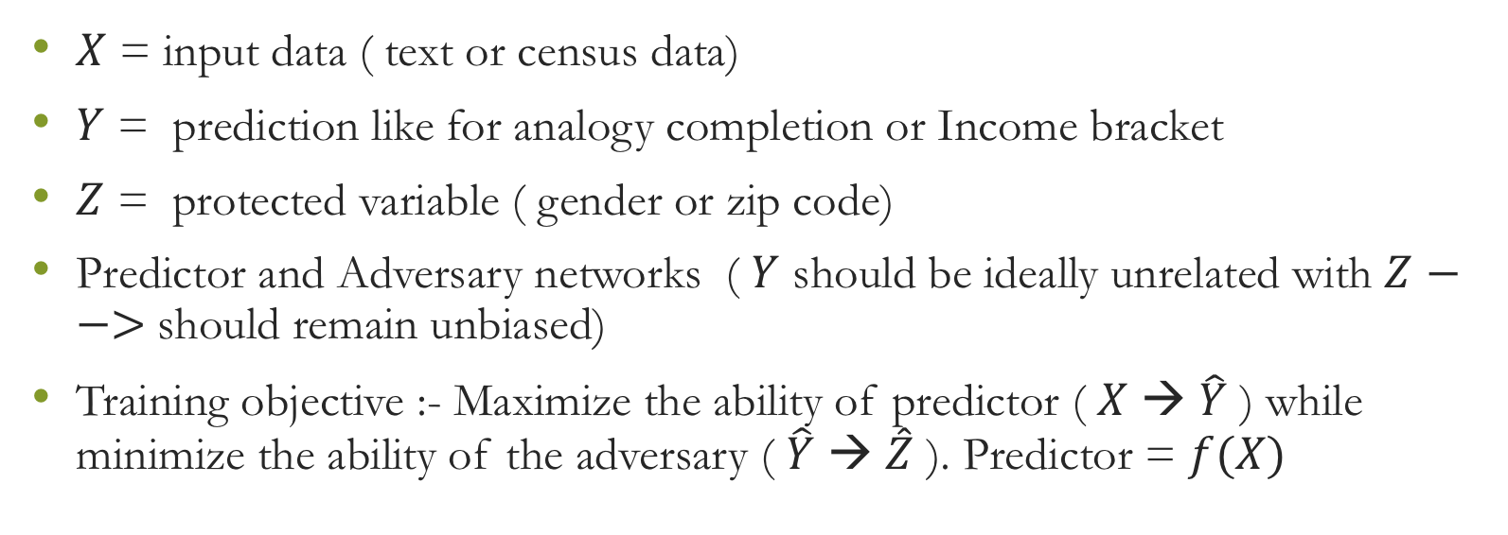
Mitigating bias :- Removing bias from embedding
$X$ = input data ( text or census data)
$Y$ = prediction like for analogy completion or Income bracket
$Z$ = protected variable ( gender or zip code)
Predictor and Adversary networks ( $Y$ should be ideally unrelated with $Z$ $−−>$should remain unbiased)
Training objective :- Maximize the ability of predictor ( $X$ → $\hat{Y}$ ) while minimize the ability of the adversary ( $\hat{Y}$ → $\hat{Z}$ ). Predictor = $f(X)$

Slide 4
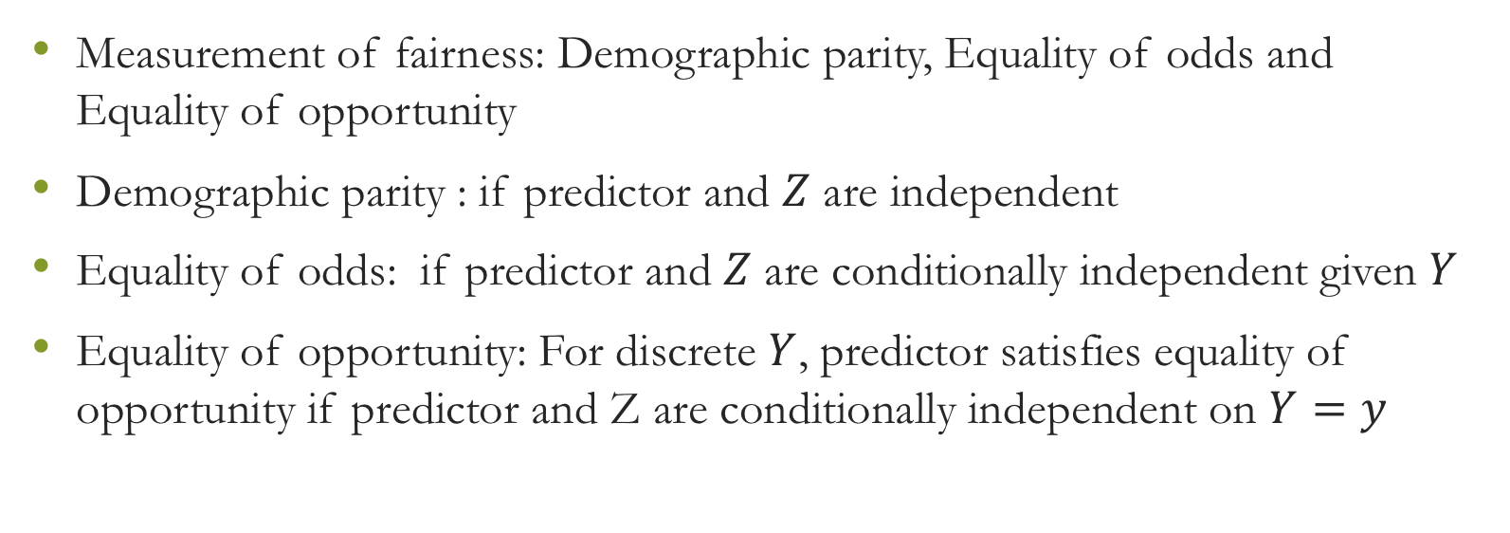
Key concepts
Measurement of fairness: Demographic parity, Equality of odds and Equality of opportunity
Demographic parity : if predictor and $Z$ are independent
Equality of odds: if predictor and $Z$ are conditionally independent given $Y$
Equality of opportunity: For discrete $Y$, predictor satisfies equality of opportunity if predictor and Z are conditionally independent on $Y=y$

Slide 5
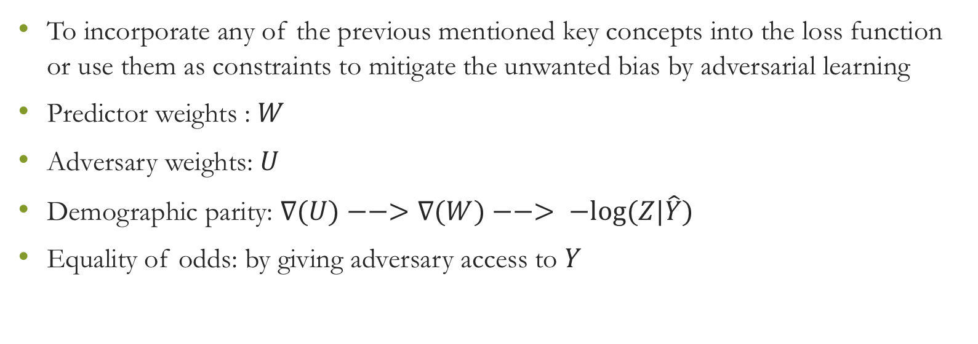
Goal
To incorporate any of the previous mentioned key concepts into the loss function or use them as constraints to mitigate the unwanted bias by adversarial learning
Predictor weights : $W$
Adversary weights: $U$
Demographic parity: $∇(U)−−>∇(W)−−> −log⁡(Z|\hat{Y})$
Equality of odds: by giving adversary access to $Y$

Slide 6
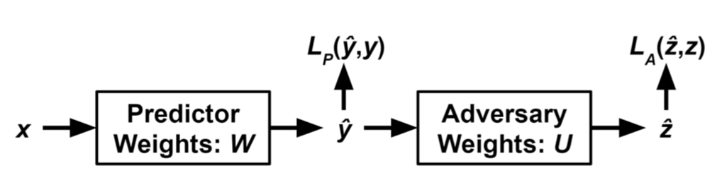

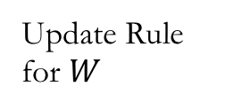
Adversarial Debiasing
1. Adversary has access to predicted label
2. Adversary gets both true and predicted label
3. Restricting the training set
Adversary loss
Predictor loss
Adversary networks behaves like discriminator network in typical GAN
Update Rule for $W$
To prevent predictor from helping adversary
Tries to increase adversary loss

Slide 7

Properties
Generality: The method can be used to enforce DEMOGRAPHIC PARITY, EQUALITY OF ODDS, or EQUALITY OF OPPORTUNITY
Model-agnostic : Can be applied to simpler or complex predictive model
Optimality: if the predictor converges, it must converge to a model that satisfies the desired fairness definition.

Slide 8


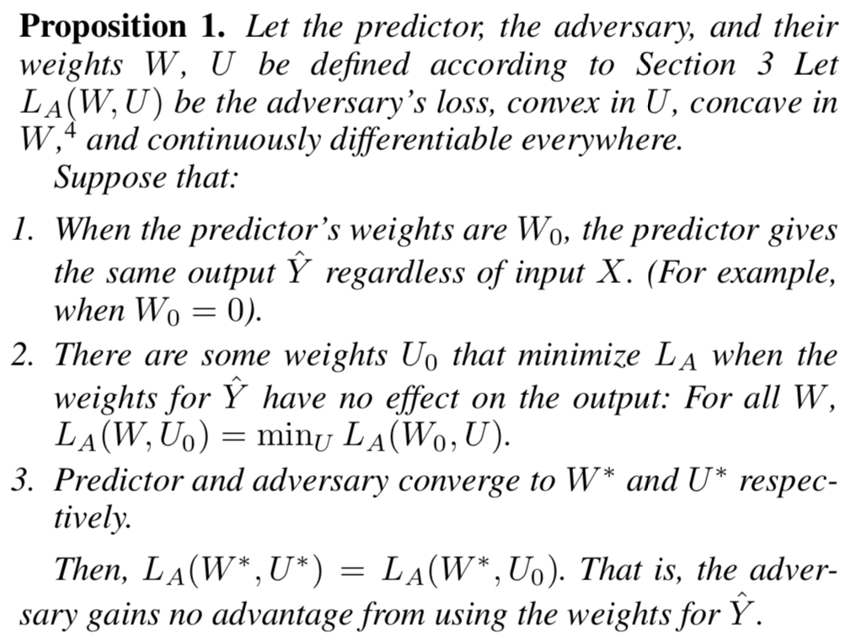
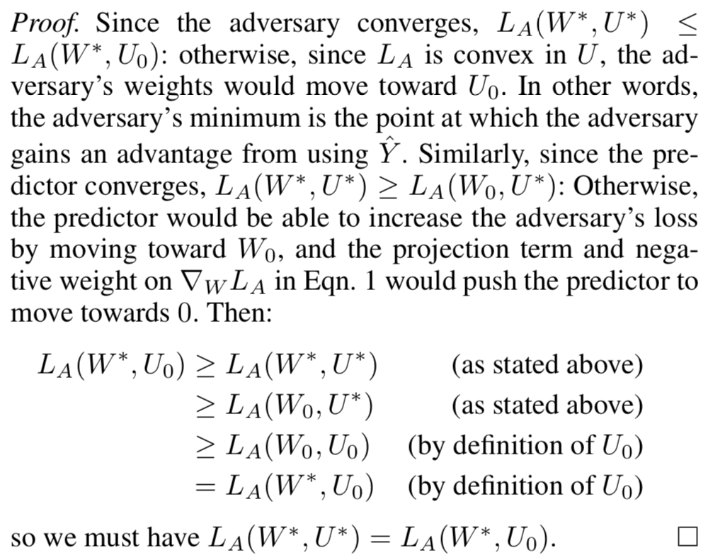


Theoretical Guarantees

Slide 9
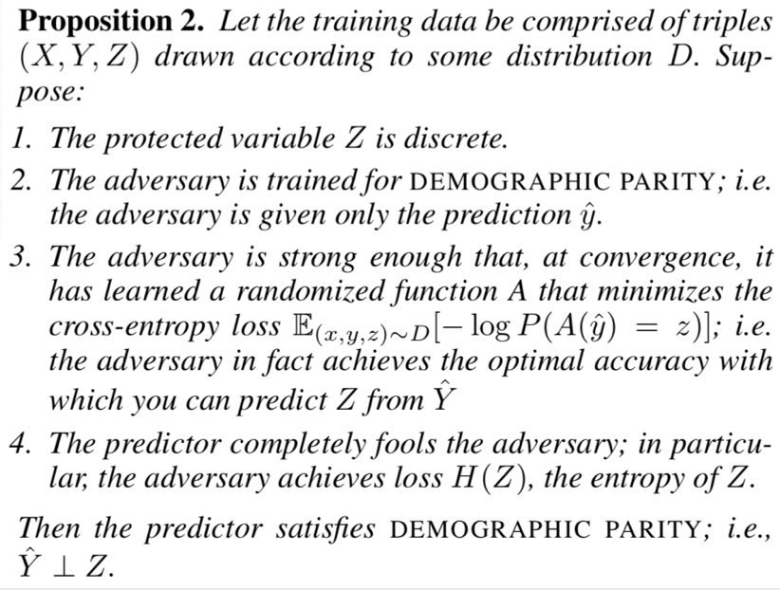
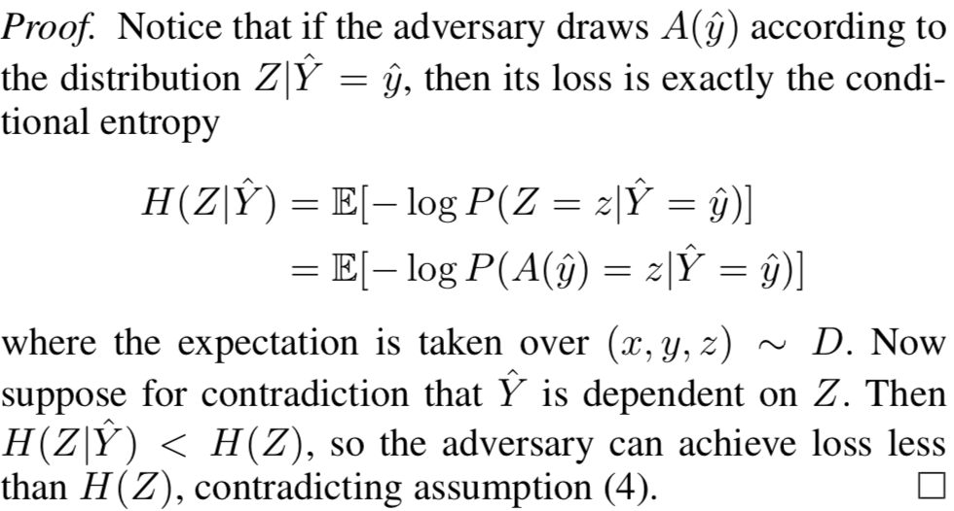
Theoretical Guarantees

Slide 10
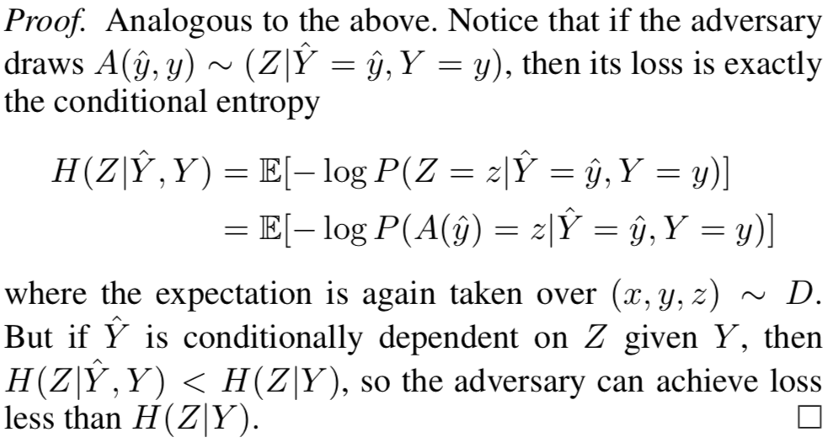
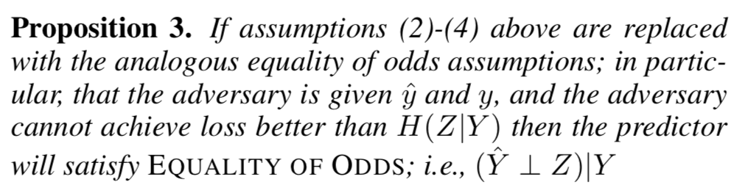
Theoretical Guarantees

Slide 11
Experiments
Toy Scenario
Word Embeddings
UCI Adult Dataset

Slide 12
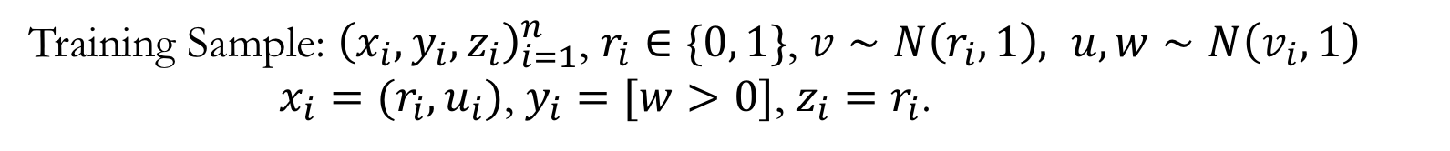
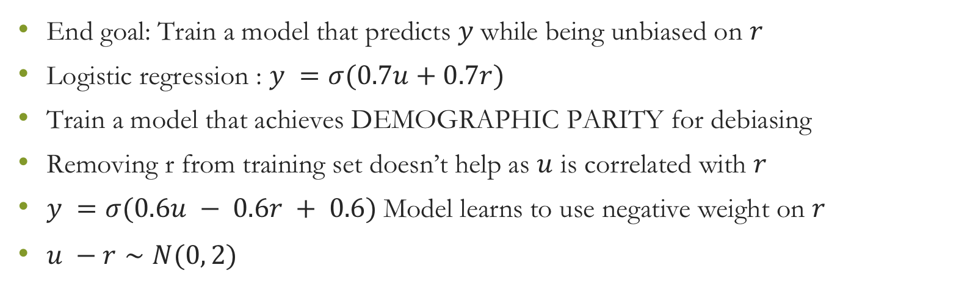
Toy Scenario
Training Sample: ${\left(x_{i},y_{i}, z_{i}\right)}_{i=1}^{n}$, $r_{i}∈\{0, 1\}$, $v∼N\left(r_{i}, 1\right), u, w∼N\left(v_{i}, 1\right)$
$x_{i}=(r_{i}, u_{i})$, $y_{i}=[w>0]$, $z_{i}=r_{i}$.
End goal: Train a model that predicts $y$ while being unbiased on $r$
Logistic regression : $y =σ(0.7u+0.7r)$
Train a model that achieves DEMOGRAPHIC PARITY for debiasing
Removing r from training set doesn’t help as $u$ is correlated with $r$
$y =σ(0.6u − 0.6r + 0.6)$Model learns to use negative weight on $r$
$u −r∼N(0, 2)$

Slide 13
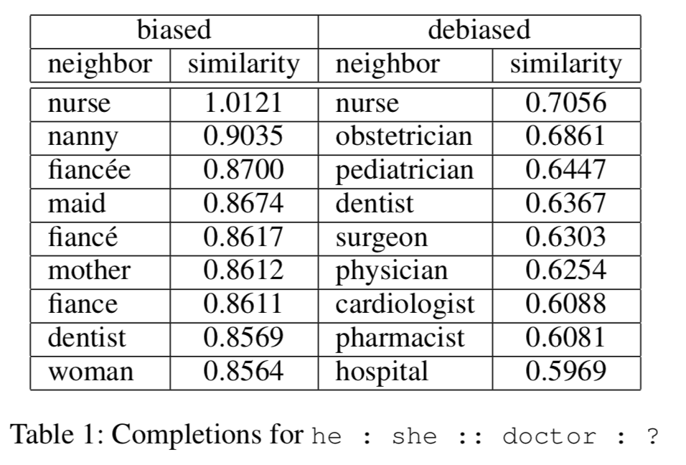
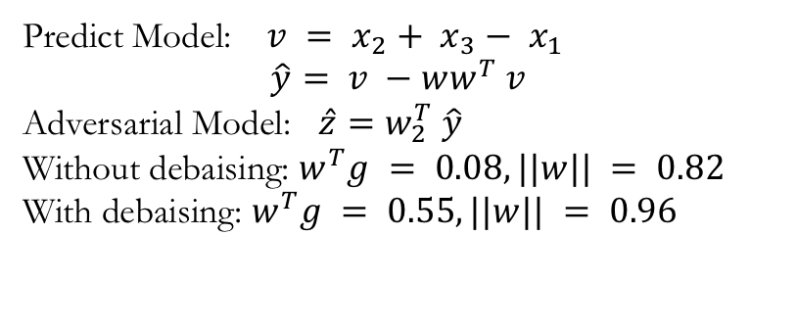
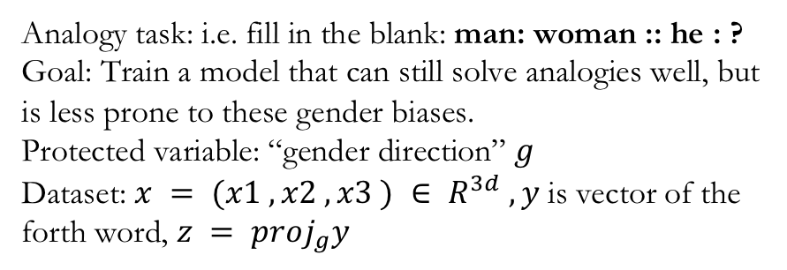
Word Embedding
Analogy task: i.e. fill in the blank: man: woman :: he : ?
Goal: Train a model that can still solve analogies well, but is less prone to these gender biases.
Protected variable: “gender direction” $g$
Dataset: $x = (x1 , x2 , x3 ) ∈ R^{3d} , y$is vector of the forth word, $z = proj_{g}y$
Predict Model: $v = x_{2}+ x_{3}− x_{1}$
$$\hat{y}= v −ww^{T} v$$
Adversarial Model: $\hat{z}=w_{2}^{T} \hat{y}$
Without debaising: $w^{T}g = 0.08, ||w|| = 0.82$
With debaising: $w^{T}g = 0.55, ||w|| = 0.96$

Slide 14
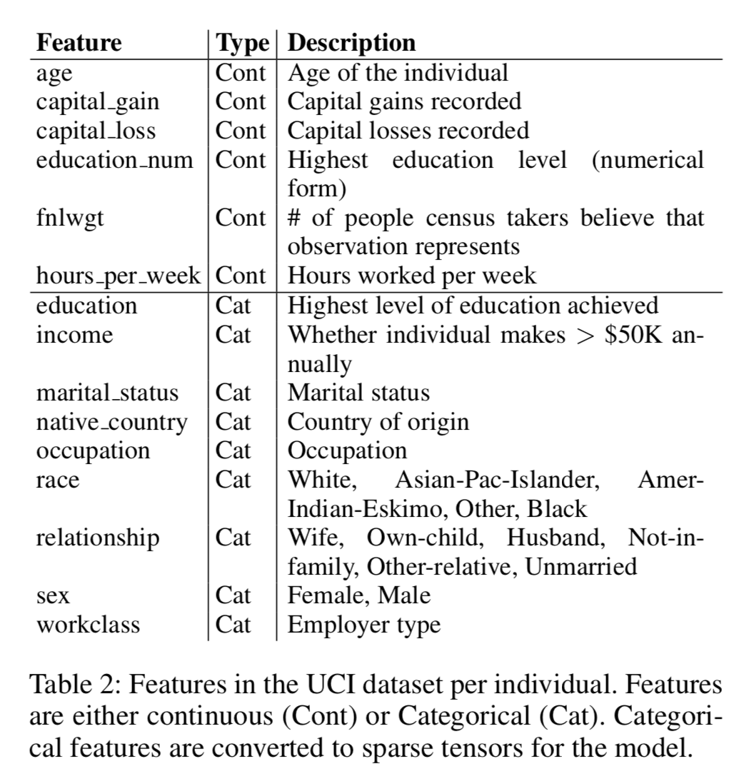

UCI Adult Dataset
Task : Enforce EQUALITY OF ODDS on a model for the task of predicting the income of a person – in particular, predicting whether the income is > $50k – given various attributes about the person
Inputs: Give the adversary access to the true label $y$
$z:$ A binary-valued variable for the two sexes annotated, Male and Female.
Goal: Prevent the predictor’s predictions $\hat{y}$ giving additional information about $z$

Slide 15
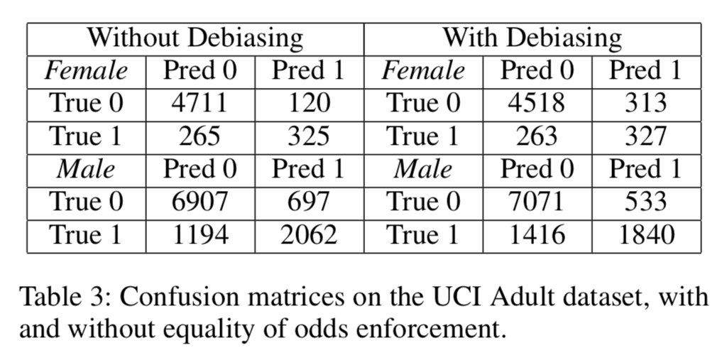
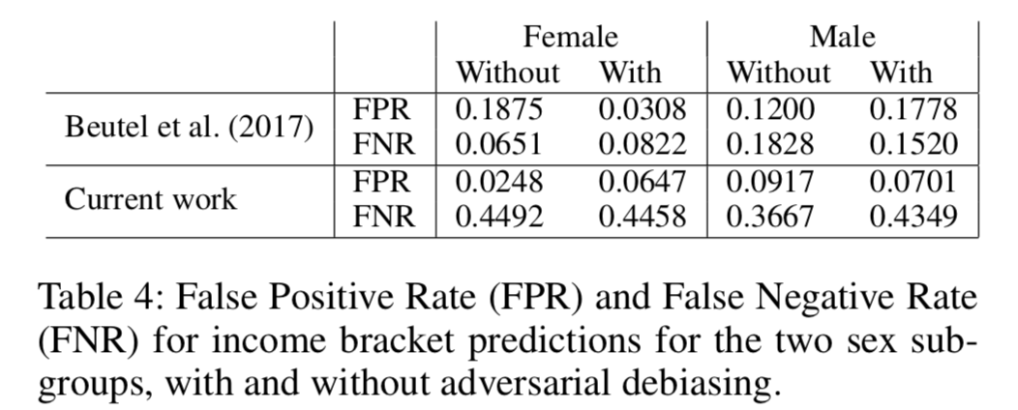
UCI Adult Dataset
Predictor Model: Logistic Regression
Adversary model: Logistic regression-like model
Accuracy: 86.0% vs 84.5%

Slide 16
Conclusion and Future Work
Contribution
Authors demonstrated a general and powerful method for training unbiased machine learning models
Provides theoretical guarantees for their method
Applies the method in practice to two very different scenarios: one standard supervise learning task and the task of debiasing word embeddings while still maintaining ability to perform a certain task(analogies)
Extension
Are word embeddings they trained useful in more complex tasks?
What ways can be used to stabilize training and ensure convergence?
Can we combine multiple adversaries to create high accuracy image recognition systems?
Do more complex predictors require more complex adversaries?

